Slide 1


What God Is Doing
Through Us
Together in Mission
English District
The Lutheran Church—Missouri Synod

Slide 2

Who is the English District?
YOU ARE!

Slide 3
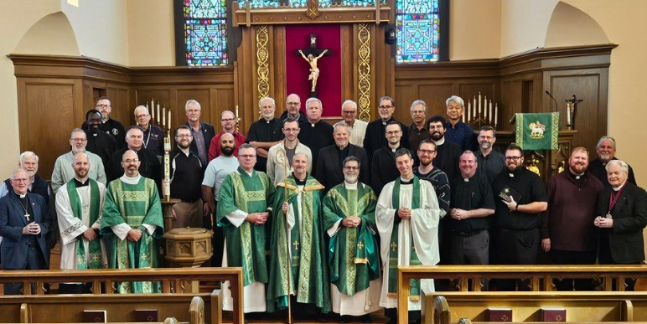
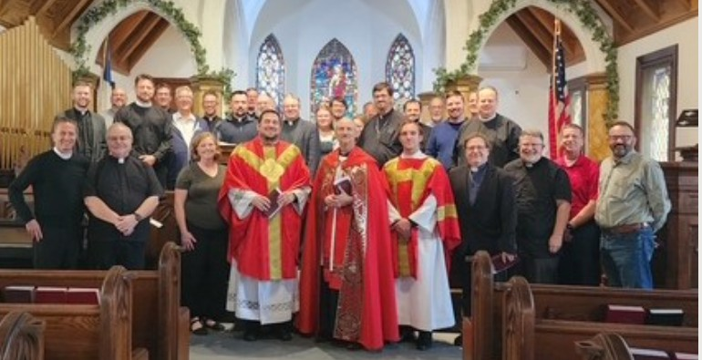
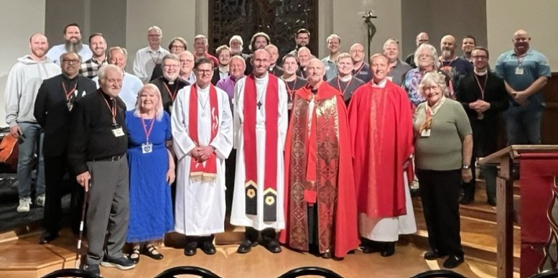
The English District Serves…
442 Church Workers

Slide 4
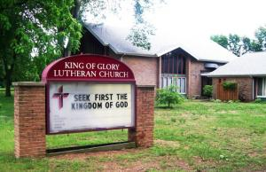
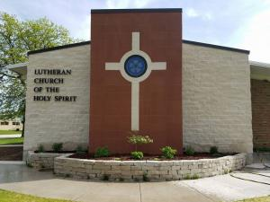
The English District Serves…
155 Congregations, Mission
Starts, Missions Overseas

Slide 5

The English District Serves…
3. 42 Schools
4. 29 Languages

Slide 6
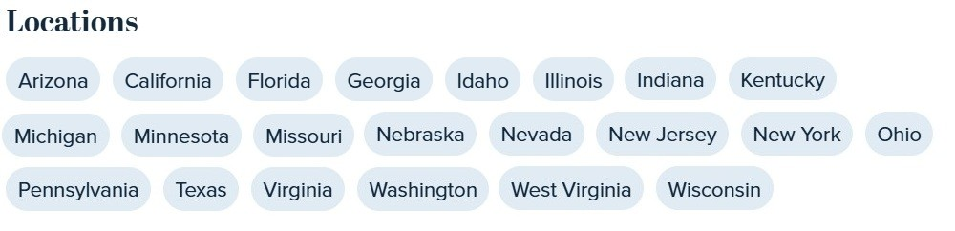
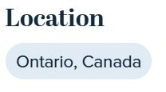
The English District Serves…
5. 22 States in the U.S.
6. 1 Province in Canada

Slide 7
The District Serves 4 Key Ministries
Congregations
2. Schools
3. Pastors and Church Workers
4. Synod

Slide 8
The District Serves CONGREGATIONS by…
Partnering to plant churches.
Supporting ongoing missions and campus ministries.
Providing resources, guidance, and support to all congregations at all stages.
Connecting congregation leaders with professionals for building projects.

Slide 9
The District Serves CONGREGATIONS by…
Assisting calling congregations in need of a pastor.
Providing ecclesiastical oversight.
Helping congregations in need of mercy.
Helping closing congregations become mission legacies.

Slide 10
CONGREGATIONS: Partnering to plant churches
The district comes alongside congregations or gatherings of Lutherans to plant a church.
Church Planting Simplified provides step-by-step procedures.

Slide 11
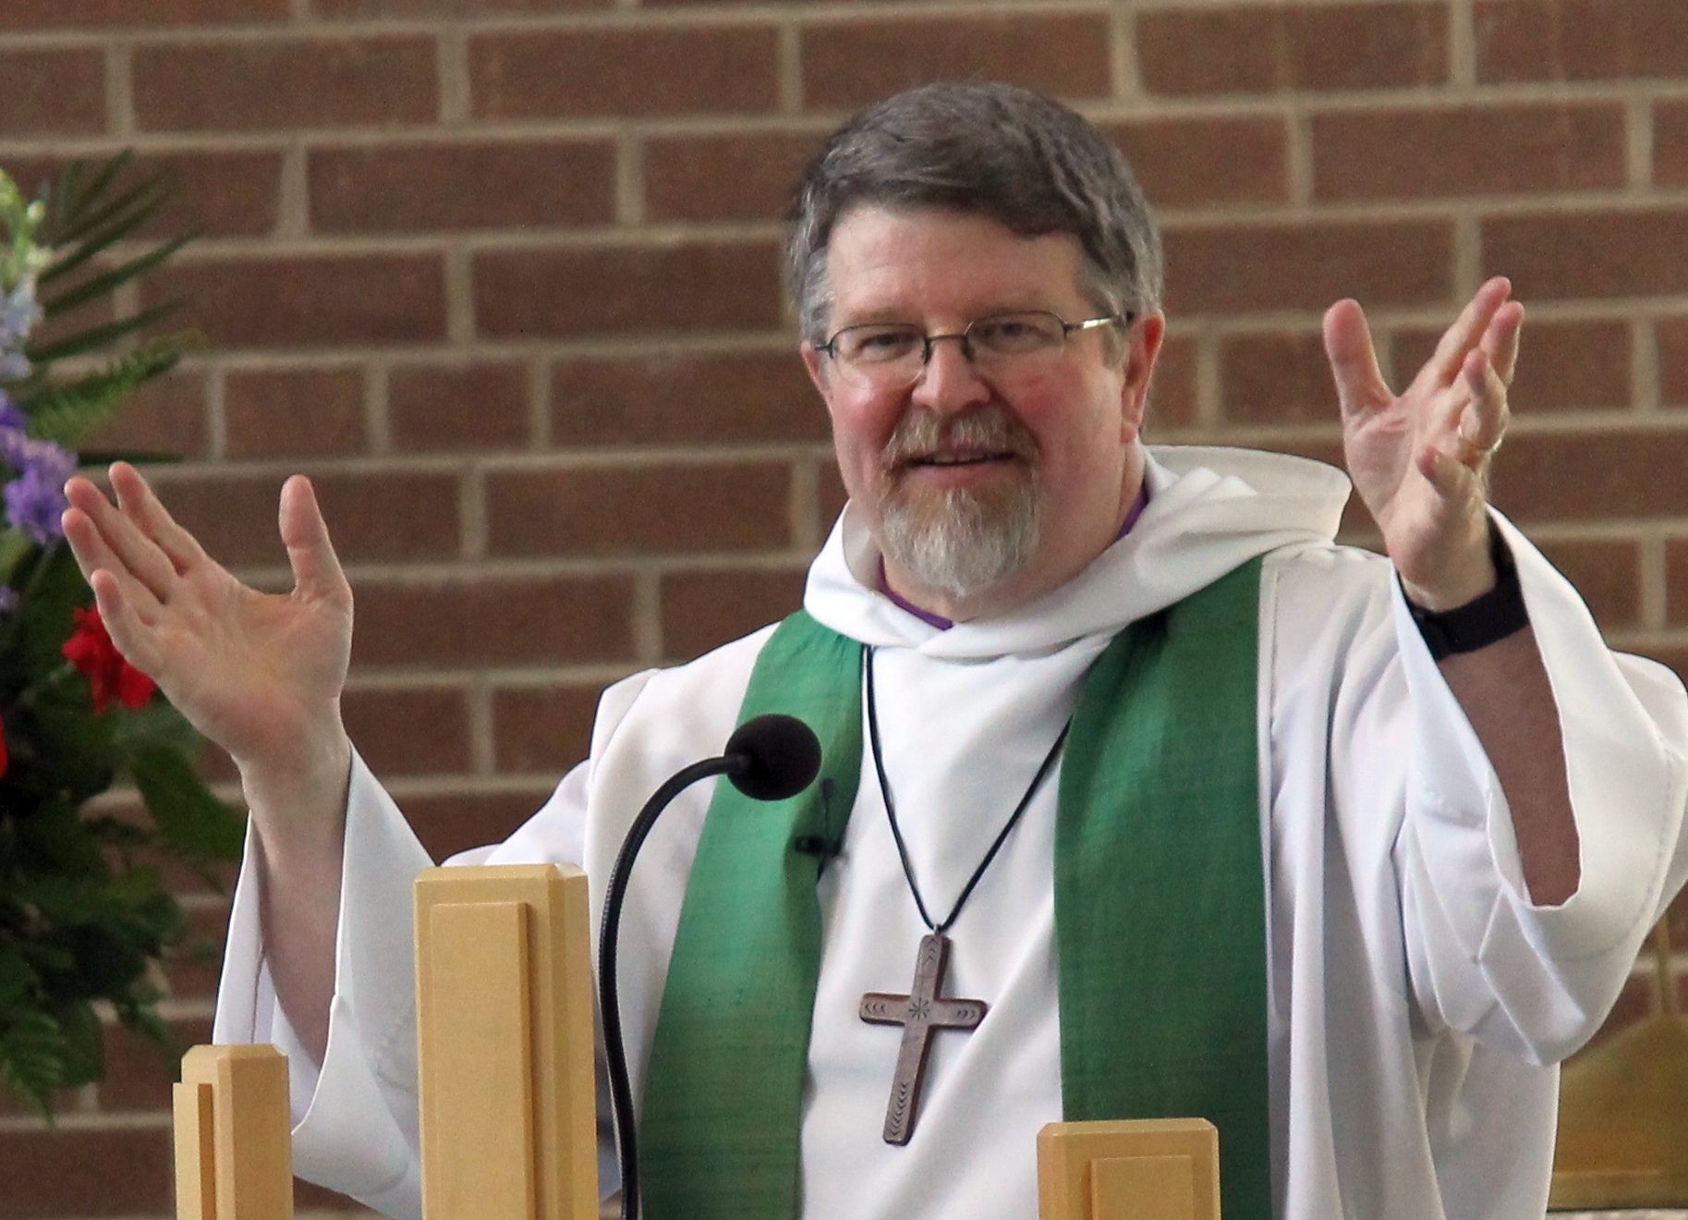
CONGREGATIONS: Partnering to plant churches
Church Planting Simplified is supported by Rev. Derek Mathers.
  accountability
  support
  encouragement

Slide 12
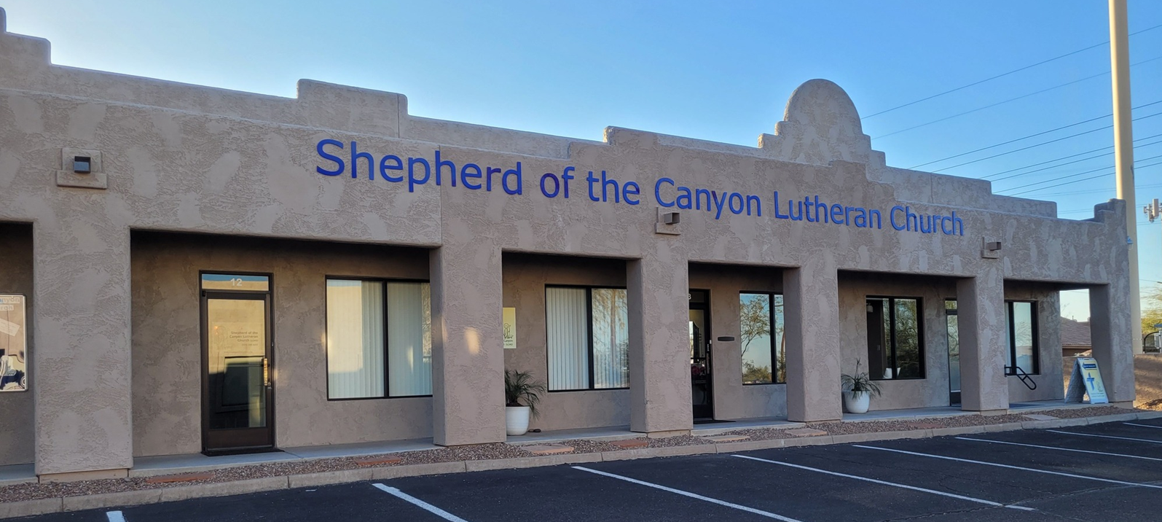
CONGREGATIONS: Partnering to plant churches
Funding opportunities become available as Church Planting Teams follow the process.
  Shepherd of the Canyon Lutheran Church, Gold Canyon, AZ

Slide 13
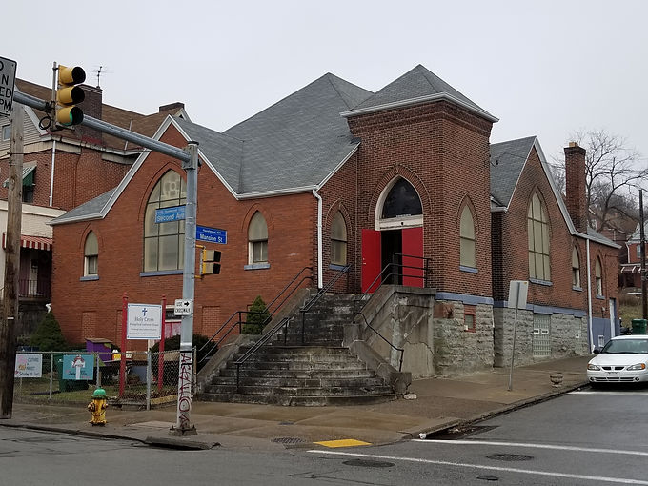
CONGREGATIONS: Supporting ongoing missions and campus ministry
District supports mission congregations.
Holy Cross Lutheran Chapel, Pittsburgh, PA

Slide 14
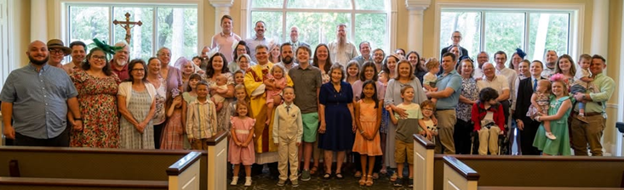
CONGREGATIONS: Supporting ongoing missions and campus ministry
St. Thomas Lutheran Church, Magnolia, TX

Slide 15
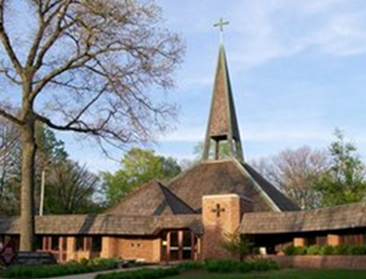
CONGREGATIONS: Supporting ongoing missions and campus ministry
Funds from district congregations accomplish together what one congregation may not have the financial resources to do on its own such as funding Campus Ministries.
  Martin Luther Chapel, East Lansing, MI

Slide 16
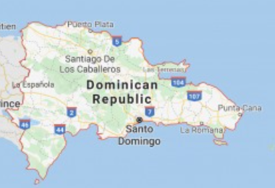
CONGREGATIONS: Supporting ongoing missions and campus ministry
District missions are trusted churches and organizations with accountable administration.
Missions are visited and supported by ensuring accordance with mission statements and governing documents and providing financial oversight.
  Dominican Republic Lutheran Mission Partnership

Slide 17
CONGREGATIONS: Providing resources, guidance, and support to all congregations at all stages
CADDS (Congregational Assessment of Development/Decline Status) a tool created by synod for congregations to evaluate their purpose and direction.
Rev. Derek Mathers leads congregations through this self-examination process.

Slide 18
CONGREGATIONS: Providing resources, guidance, and support to all congregations at all stages
Congregations may utilize other synod-created resources, without cost, from the suite of Re:Vitality modules like CADDS.
Shepherding Our Strays, to engage individuals who have become separated from the spiritual life of the congregation.

Slide 19
CONGREGATIONS: Providing resources, guidance, and support to all congregations at all stages
Connect to Disciple, for improving the effectiveness of a congregation’s outreach efforts.
Serving in God’s Mission (SGM), a strategic planning process tailored for Lutheran congregations.

Slide 20
CONGREGATIONS: Providing resources, guidance, and support to all congregations at all stages
Congregations are assisted in their efforts to grow, merge, or become dual parishes that share resources.
Exploring God’s Mission Here Bible Study, facilitates tough conversations within congregations that are in challenging spots.

Slide 21
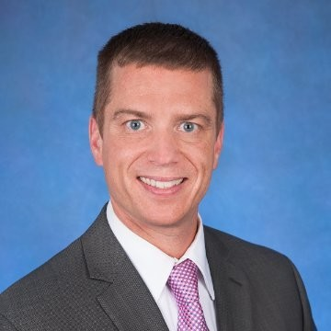
CONGREGATIONS: Connecting congregation leaders with professionals for building projects, loans, investments, and long-term financial planning advice.
The Lutheran Church Extension Fund (LCEF)
Mr. John Hoover works with congregations who may need funds to build or renovate.

Slide 22
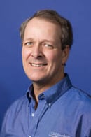
The LCMS Foundation
Mr. Ron Grimm works with English District congregations and members who wish to invest in ministry and missions through investments, endowment funds, and charitable giving.

Slide 23
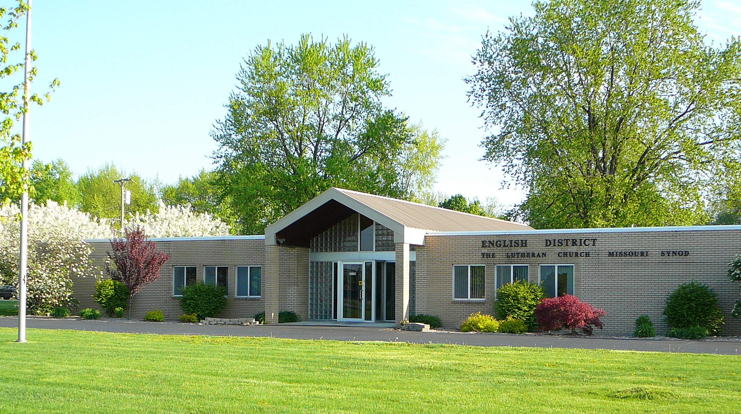
CONGREGATIONS: Assisting calling congregations in need of a pastor (and church workers).
Circuit Visitor meets with and shepherds the congregations during vacancy.
Support provided to Congregation Call Committees by Bishop/President and district assistants.

Slide 24
CONGREGATIONS: Assisting calling congregations in need of a pastor (and church workers).
Review of the congregation’s CADDS results.
Review Congregation Self-study.
Consider congregation nominations.
Prepare list of pastors for call consideration.
Celebrate with the congregation when God provides a pastor.

Slide 25
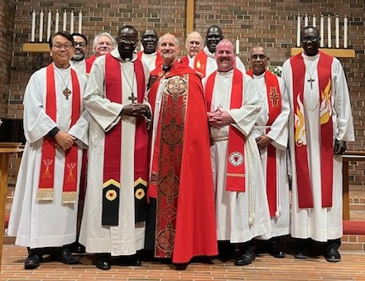
CONGREGATIONS: Assisting calling congregations in need of a pastor (and church workers).
Bishop (or his representative) visits and the pastor is installed according to Christ’s Word.
Assist congregations as they call other Church workers (i.e. Deaconesses, DCEs, etc.).

Slide 26
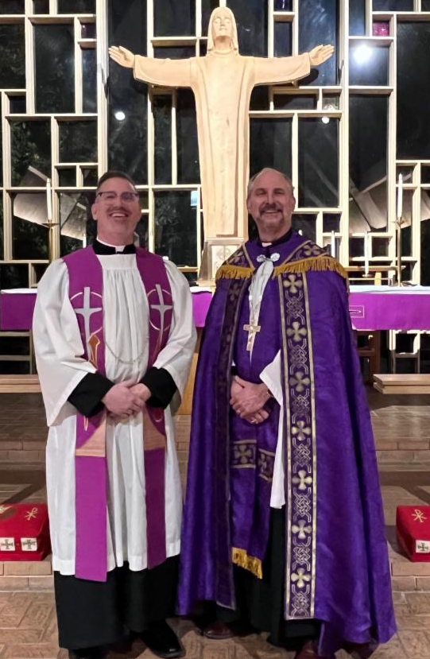
CONGREGATIONS: Providing Ecclesiastical Oversight
Visit congregations each triennium emphasizing the joy of serving together in mission and ministry of Christ’s church through:

Slide 27
CONGREGATIONS: Providing Ecclesiastical Oversight
Worship
Communion Attendance
Missions
Education
Stewardship
Caring for the pastor

Slide 28
CONGREGATIONS: Providing Ecclesiastical Oversight
Oversee the teachings of the pastors and congregations.
Assume the role of an encouraging brother in Christ, shepherding the shepherds.
Provide help and counsel when congregations suffer conflict.
Conduct investigations when controversies arise.

Slide 29
CONGREGATIONS: Helping congregations in need of mercy
Harness the congregations of both district and synod to supply help when tragedy strikes.
Wildfires
Tornadoes
Floods
Hurricanes
Other disasters

Slide 30
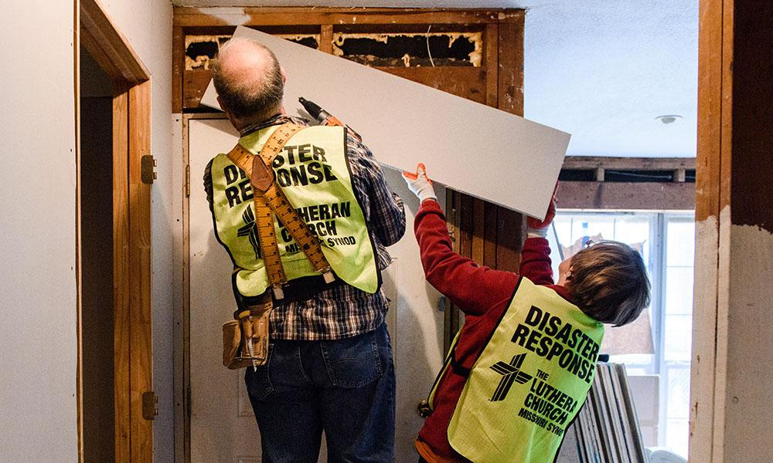
CONGREGATIONS: Helping congregations in need of mercy
Utilize district resources with funding, feet on the ground, and tragedy support.
Lutheran Early Response Team (LERT)

Slide 31
CONGREGATIONS: Helping closing congregations become mission legacies
Guide congregation to respectfully end its ministry with a proper closing worship service often led by the bishop.
Assist the remaining members to dissolve and distribute their assets as a legacy toward the future mission work of the church.

Slide 32
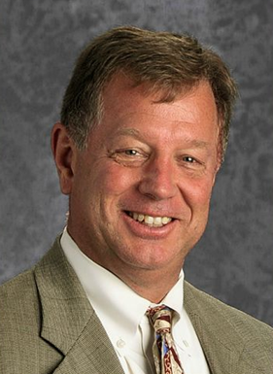
The District Serves SCHOOLS
Assist congregations to start or expand a school with the guidance of Education Executive Mr. Albert Amling.

Slide 33
The District Serves SCHOOLS
Oversee current district congregation schools with extensive knowledge and experience.
Visit district schools annually and serve as needed.
National Lutheran School Accreditation (NLSA) oversight.
Assist schools when calling faithful, rostered Lutheran teachers.

Slide 34

The District Serves PASTORS and CHURCH WORKERS
The Ministerial Health Commission assists pastors and church workers with health and wellbeing challenges.
Provides resources
Listens with care and confidentiality

Slide 35
The District Serves PASTORS and CHURCH WORKERS
Encourages pastors and church workers to meet, fellowship, study, and worship together in regional and district conferences.
Circuit visitors provide support to church workers.
Bishop meets individually with each pastor every triennium.

Slide 36
The District Serves SYNOD
Connects your congregation to her sister congregations of the Synod to rejoice and support each other.
Servant to Servant weekly newsletter
Website: englishdistrict.org
Social Media: Facebook and Instagram

Slide 37
The District Serves SYNOD
Promotes Synod programs such as “Set Apart to Serve” to encourage members to become church workers.
Encourages young people to attend and grow in their faith and to serve Him at Lutheran seminaries and universities.
Reports to the synod on the district’s overall ministry every three years at the Synod convention.

Slide 38

The District Serves SYNOD
Connects the congregations, circuits, and delegates to the Synod’s National Convention.
Maintains the official roster of the synod/district.

Slide 39
Your congregation’s financial support to the English District is:

Slide 40
Planting churches.
Supporting trusted missions and campus ministries.
Providing resources and guidance to support growing or struggling congregations.
Providing call lists to congregations in need of a pastor and other church workers.

Slide 41
Providing ecclesiastical oversight.
Serving congregations in need of mercy.
Helping closing congregations become mission legacies.
Starting and supporting schools.
Supporting efforts toward healthy church workers.

Slide 42
Connecting the local congregation to the wider church.
Promoting valued time-tested synodical programs and institutions.

Slide 43

What Can YOU DO?
Pray for the churches, schools, workers, and missions of the English District by name.

Slide 44

What Can YOU DO?
Give a percentage of your congregation’s budget to the ministry of the English District.

Slide 45

What Can YOU DO?
Offer to serve on District Boards and Commissions.

Slide 46
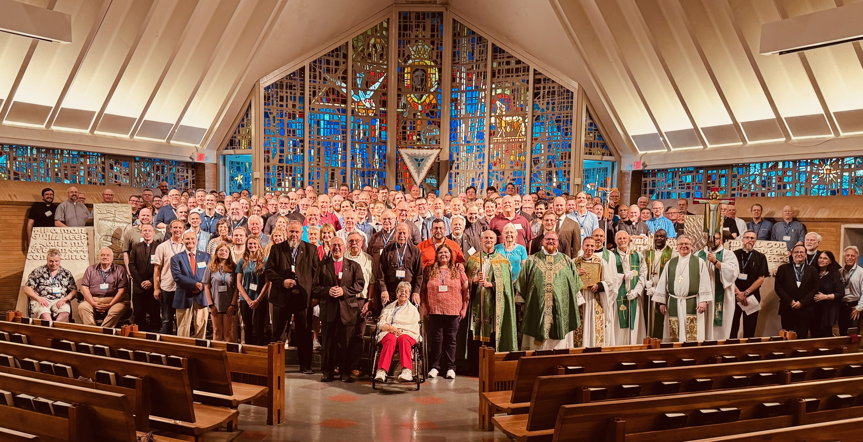
What Can YOU DO?
Register and attend the District Convention.

Slide 47
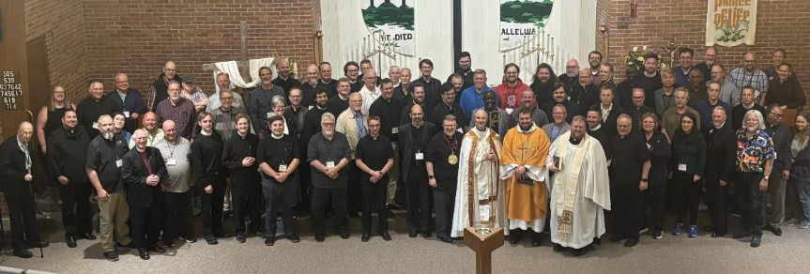
What Can YOU DO?
Encourage and pay for your pastor to attend District Conferences.

Slide 48
May our gracious God continue His work through the English District
As we live our baptized lives in Christ
Together in Mission.
Glory be to God!

